Slide 1
LOCAL IMAGE SEARCH ENGINE USING DEEP LEARNING
TEAM MEMBERS: PROJECT GUIDE:
Mathu mozhi sp Ms.Hepsi Ajibah
Nithyasri B

Slide 2
ABSTRACT
This project develops an Local image search engine using deep learning techniques. It employs CNNs with VGG16 architecture for feature extraction and GloVe word embeddings for semantic understanding. The Annoy library facilitates efficient image retrieval based on content. Implemented in Google Colab with GPU acceleration, key functionalities include CNN model training, image feature indexing, and storage in a Python-based database. Users can query using text or images, receiving related sets based on content. Emphasis is on system prerequisites, scalability with image volume, and applicability to diverse image-based tasks.

Slide 3
OBJECTIVE
Develop a local image search engine using CNNs with VGG16 architecture and GloVe word embeddings.
Implement feature extraction to capture detailed visual representations.
Incorporate semantic understanding of image content.
Design an efficient indexing mechanism using the Annoy library for retrieving similar images.
Utilize Python locally for system implementation.
Provide step-by-step training of the CNN model for optimal performance.
Develop a robust storage system using a Python-based database for processed image data.
Enable user queries using text descriptions or image inputs.
Emphasize system prerequisites, scalability, and comprehensive functionality.

Slide 4
LITERATURE SURVEY

Slide 5
Sl. No. | Author, Title, Journal, Year | Methodology | Advantages | Disadvantages
1. | Aman Kumar , Danish Raza Rizvi, "Knowledge Weightage Calculation: an AI & ML based smart modelling for text- content summarization and quantification", 2023, (ICRT) | Neural network-based text summarization | Automated summarization Quantification of text content | Dependency on AI & ML algorithms Potential bias in summarization
2. | Robert Hönig, Jan Ackermann, Mingyuan Chi, "Bi-Encoder Cascades for Efficient Image Search", 2023, IEEE/CVF International Conference on Computer Vision Workshops (ICCVW) | Bi-Encoder Cascades approach | Improved search efficiency Enhanced retrieval accuracy | Potential trade-off between efficiency and accuracy Dependency on the quality of training data

Slide 6
Sl. No. | Author, Title, Journal, Year | Methodology | Advantages | Disadvantages
3. | Anushri Eswaran, Varshini E, "Reverse Image Search Engine for Garment Industry", 2022 8th International Conference on Advanced Computing and Communication Systems (ICACCS) | Reverse image search engine development | Potential for improving inventory management Enhanced image-based product discovery | Dependency on image quality and metadata accuracy Challenges in scaling to large datasets
4. | K. Praveen Kumar, V. Prakash Reddy, G. Indra Karan Reddy, N.S. Ganesh, “Building an Image Search Engine with Deep Learning”, 2022 International Journal of Creative Research Thoughts (IJCRT) | Deep learning-based image search engine development | Utilization of advanced deep learning techniques Enhanced image retrieval accuracy | Complexity in model training and optimization Dependency on labeled training data

Slide 7
Sl. No. | Author, Title, Journal, Year | Methodology | Advantages | Disadvantages
5. | Shravya G, Prof. Smitha G R, “Image Search Engine and Individual Profile Building”, 2021 International Journal of Innovative Research (IJIR) | Integration with individual profile building | Enhanced user engagement and satisfaction Potential for targeted content recommendations | Privacy concerns related to profile building Complexity in profile management and updating

Slide 8
EXTRACT FROM LITERATURE SURVEY
Using VGG16 neural network from convolution neural net (CNN).
architecture which was used to win ILSVR(Imagenet) competition in 2014.
able to classify 1000 images of 1000 different categories with 92.7% accuracy.
Using GloVe for word representation
a type of word embedding that encode the co-occurrence probability ratio between two words as vector differences.
Using Annoy to find nearest neighbor
C++ library with Python bindings to search for points in space that are close to a given query point.

Slide 9
EXISTING SYSTEM
Presently the image search is only possible in online medium, provided images that are proposed through online search engines or privately owned websites like Adobe stock, Pinterest. There are lots of image finders out there. Some are picture search engines that scour the web for photos and continually update their database with new images. Another way to search for pictures is from websites that host images but don't necessarily crawl the web to find new ones like a search engine does.
Current offline scope for search engine are the files can be searched by the filename or files can be searched using the respective file extensions. At most searching ability in offline mode is to search with the content of text present in the documents.

Slide 10

ADVANTAGES OF PROPOSED SYSTEM
It works on local mode.
Its fetch result based on the content present in the image.
It provides similar images for all similar words associated with the query text.
Easily scalable for the new dataset, can be extended without any additional support.

Slide 11

DISADVANTAGES OF EXISTING SYSTEM
It uses text (your search terms) to search for images.
It searches for the search terms in: the filename of the image or the link text pointing to the image or text adjacent to the image
It makes a guess that the words are related to the image
It doesn’t use the image content to search the resultant image.

Slide 12
PROPOSED SYSTEM
! The proposed solution introduces an offline image search engine to overcome limitations of existing online-dependent systems.
! Images are stored as a local data archive within the system.
! A Convolutional Neural Network (CNN), specifically the VGG16 architecture, used for image classification.
! VGG16 generates image embeddings, which are stored in vector format.
! For efficient image retrieval, the system uses the ANNOY library (developed by Spotify) to fetch the nearest neighbours based on user queries.
! ANNOY helps maintain performance even when the user input deviates from expected values, enhancing the robustness of the search engine.

Slide 13
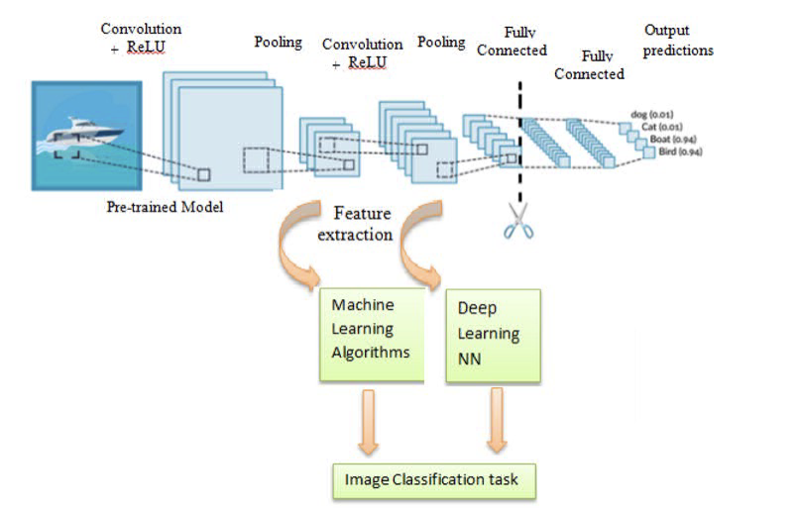
SYSTEM ARCHITECTURE

Slide 14
PROJECT MODULES
Image to Image
Text to Text
Hybrid (Tagging, Text to Image)

Slide 15
OVERVIEW
Using headless pretrained VGG16 architecture to extract image features.
Using pre-trained word vectors from GloVe.
Searching for similar images to an input image (Image → Image)
Searching for similar words to an input word (Text → Text)
Generating tags for images, and searching images using text (Image ↔ Text)

Slide 16

CONVOLUTIONAL LAYER
Convolution layer is the first layer to derive features from the input image. The convolutional layer conserves the relationship between pixels by learning image features using a small square of input data. It is the mathematical operation which takes two inputs such as image matrix and kernel or any filter.

Slide 17
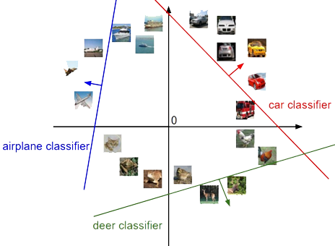
ReLu Layer
Rectified Linear unit(ReLU) transform functions only activates a node if the input is above a certain quantity. While the data is below zero, the output is zero, but when the input rises above a certain threshold.
Its increases the Non-Linearity in the learning, hence otherwise model become a traditional linear classifier.

Slide 18
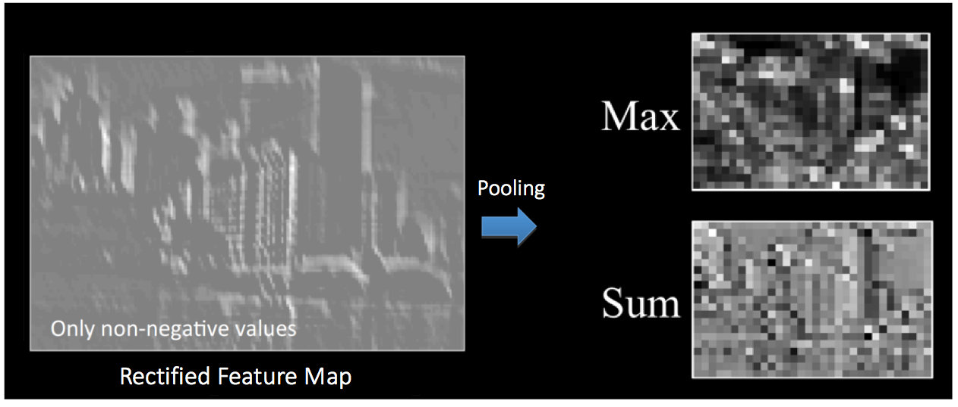
POOLING
pooling, shrinks the size of each feature map by 75% or more. This allows only the most important features to be retained, thus reducing the number of learnable features of the model.

Slide 19
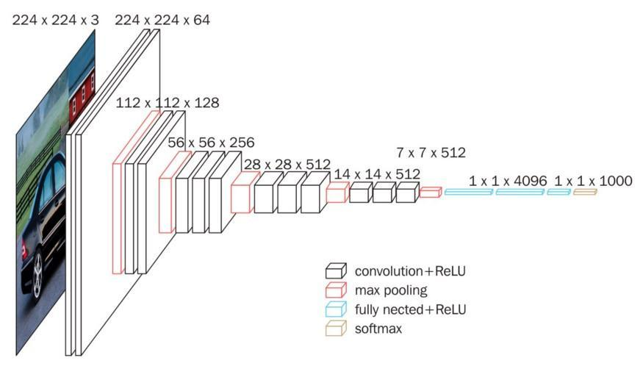
VGG16 - Visual Geometry Group 16 layers

Slide 20
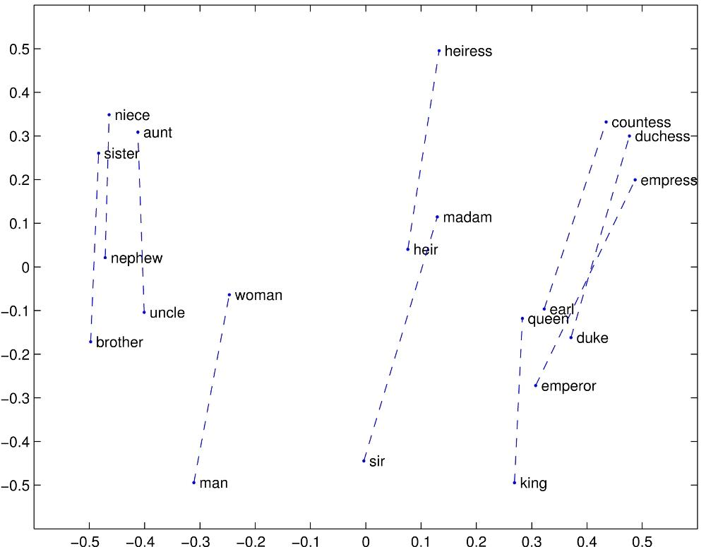
GloVe – Word Vectors Indexing
GloVe is an unsupervised learning algorithm for obtaining vector representations for words.
Training is performed on aggregated global word-word co-occurrence statistics from a corpus, and the resulting representations showcase interesting linear substructures of the word vector space.

Slide 21
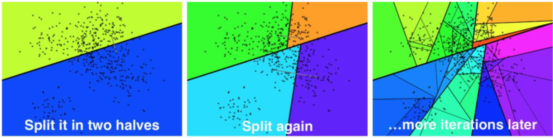
ANNOY
Annoy (Approximate Nearest Neighbors Oh Yeah) is a C++ library with Python bindings to search for points in space that are close to a given query point. It also creates large read-only file-based data structures that are mapped into memory so that many processes may share the same data.

Slide 22
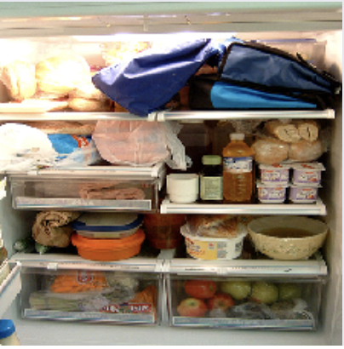
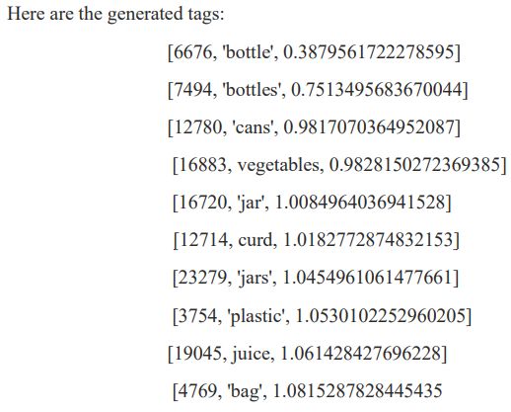
TAGGING - IMAGE TO TEXT
We can now easily extract tags from any image by simply feeding our image to our trained network, saving the vector of size 300 that comes out of it, and finding the closest words in our index of English words from GloVe.

Slide 23
CONCLUSION
The user can pass the search query as word as well as an image. For image as the query input, the module sees for the objects present in the image and generate feature vector accordingly and look for the similar feature vector in the index of already generated feature vector. The result will consist of all similar images that contains similar objects from the query image. For text as the query input, the module sees for all the closest similar words related to it, the result will be images that contain object related to the similar words generated.

Slide 24
FUTURE WORKS
Building Semantic Search
Using FastText proposed by Facebook as word embedding. It is an extension to Word2Vec and follows the same Skip-gram and CBOW model.
Able to encode unknown or out-of-vocabulary words.
Building a Standalone Application
Can be used instantly after software installation, including all Neural networks, dataset and trained model within it.
ions with multi-word queries, allowing the module to effectively process complex search queries.
Enhanced Sentence Embedding
Integrates ELMo, InferSent, and SBERT for generating comprehensive sentence embeddings, improving the comprehension of textual content.
Improved Handling of Multi-word Queries
Resolves previous limitations with multi-word queries, allowing the module to effectively process complex search queries.

Slide 25
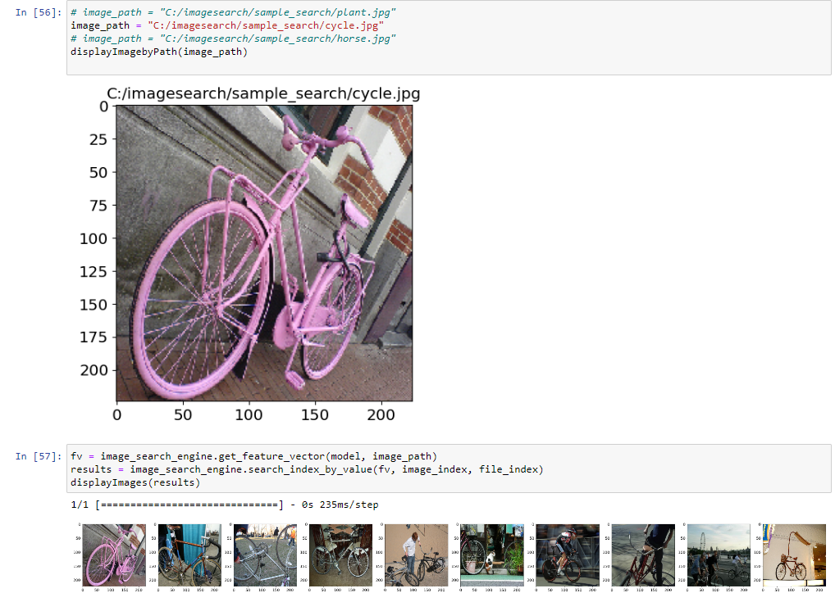
OUTPUT

Slide 26
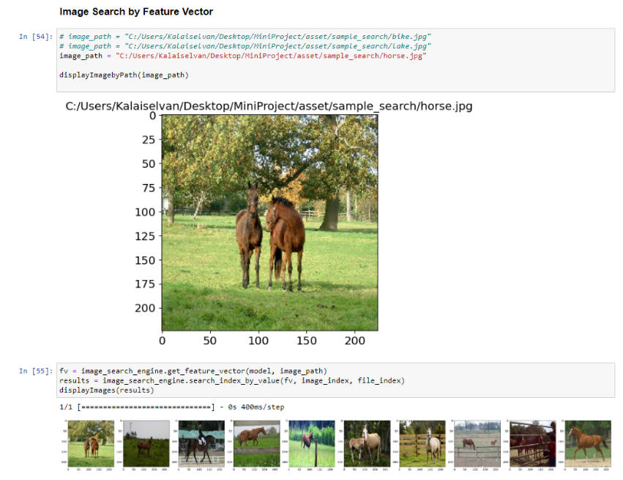
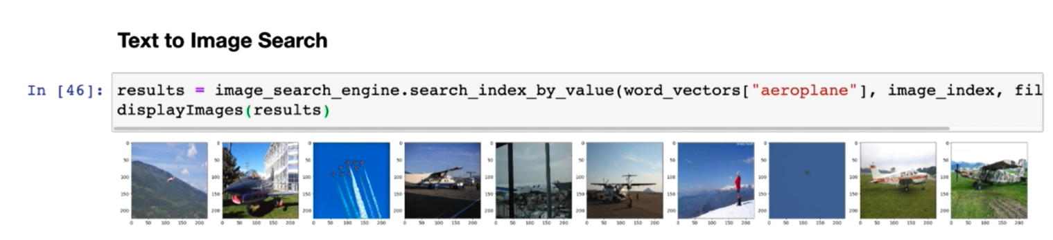

Slide 27
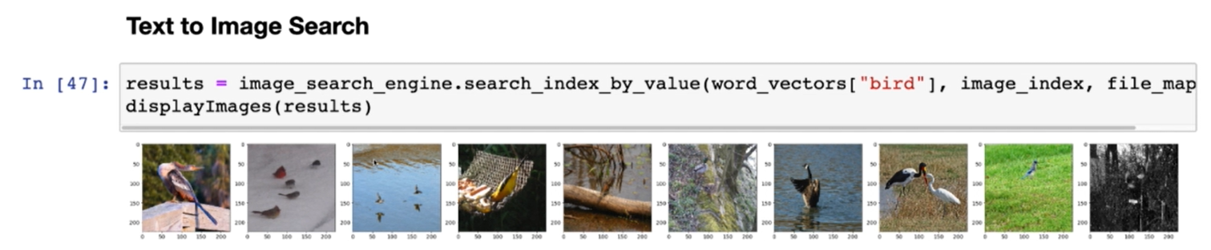
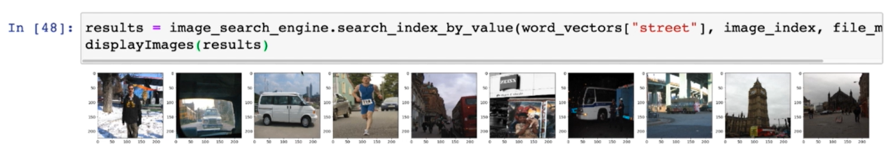
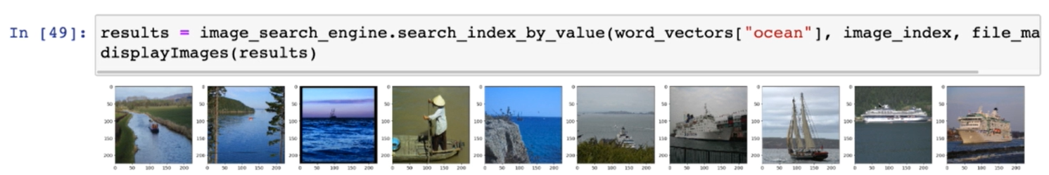

Slide 28
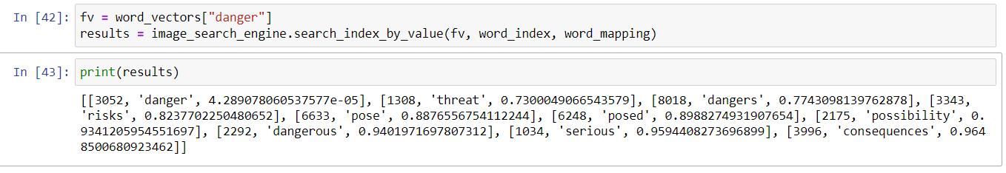
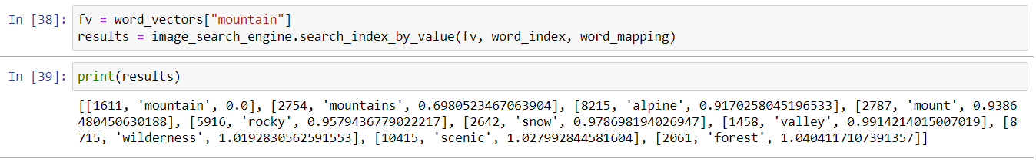
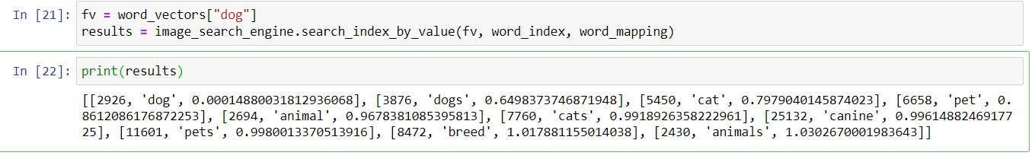

Slide 29
REFERENCES
Aman Kumar, Danish Raza Rizvi, "Knowledge Weightage Calculation: an AI & ML based smart modelling for text- content summarization and quantification",Published in: 2023 1st International Conference on Intelligent Computing and Research Trends (ICRT)
Robert Hönig, Jan Ackermann, Mingyuan Chi, "Bi-Encoder Cascades for Efficient Image Search", Published in: 2023 IEEE/CVF International Conference on Computer Vision Workshops (ICCVW)
Anushri Eswaran, Varshini E, "Reverse Image Search Engine for Garment Industry" Published in: 2022 8th International Conference on Advanced Computing and Communication Systems (ICACCS)
K. Praveen Kumar, V. Prakash Reddy, G. Indra Karan Reddy, N.S. Ganesh, “Building an Image Search Engine with Deep Learning” Published in: 2022 International Journal of Creative Research Thoughts (IJCRT)
Shravya G, Prof. Smitha G R, “Image Search Engine and Individual Profile Building” Published in: 2021 International Journal of Innovative Research (IJIR)

Slide 30
Kun Liu, Shengtao Yu, Sidong Liu, "An Improved InceptionV3 Network for Obscured Ship Classification in Remote Sensing Images", Published in: 2020 IEEE Journal of Selected Topics in Applied Earth Observations and Remote Sensing
Gede Susrama Mas Diyasa , Alfath Daryl Alhajir, Amir Muhammad Hakim Moh. Fathur Rohman, “Reverse Image Search Analysis Based on Pre-Trained Convolutional Neural Network Model” Published in: 2020 Information Technology International Seminar(ITIS)
Mery Diana, Motoki Amagasaki, Masahiro Iida, “Image Search System Based on Feature Vectors of Convolutional Neural Network” Published in: 2020 IEEE Region 10 Conference (Tencon)
Surbhi Jain, Joydip Dhar, “Image based search engine using deep learning” Published in: 2018 Institute of electrical and electronic engineers (IEEE)
Omkar Kulkarni, "Crop Disease Detection Using Deep Learning", Published in: 2018 Fourth International Conference on Computing Communication Control and Automation (ICCUBEA)

Slide 31
THANK YOU!

